Slide 1
Geometric Transformations and Their Applications in Computer Vision

Slide 2
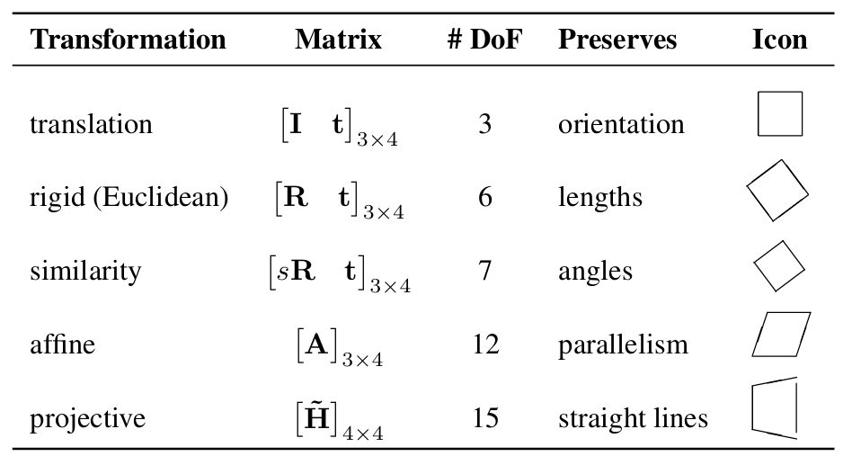

Slide 3
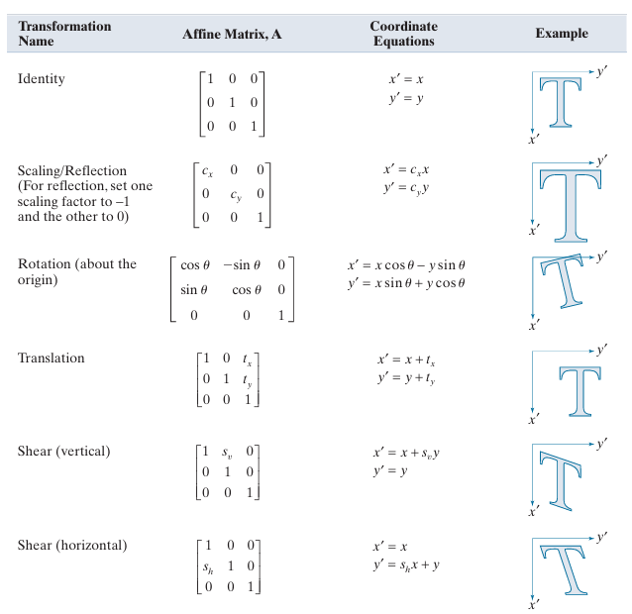

Slide 4
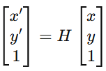
Introduction
Geometric transformations map image coordinates from one frame to another.
They describe how an image or object moves, rotates, or changes in scale.
Represented using homogeneous coordinates for unified matrix representation:

Slide 5
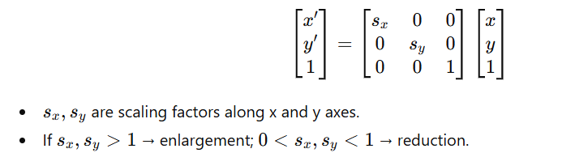
Scaling Transformation
Changes the size of an image or object.
Matrix form:
Effect: Parallel lines and shape proportions are preserved.
Example: Zooming in/out of an image.

Slide 6
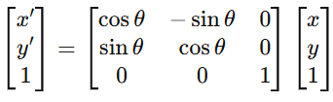
Rotation Transformation
Rotates image or object by an angle θ about the origin.
Matrix form:
Effect: Orientation changes, distances are preserved.
Example: Aligning an object with a reference orientation.

Slide 7
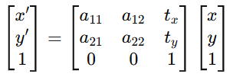
Affine Transformation
Combination of rotation, scaling, translation, and shear.
Preserves parallelism of lines, but not necessarily lengths or angles.
Matrix form:
Requires at least three pairs of corresponding points to define.
Example: Rectification of tilted camera views.

Slide 8
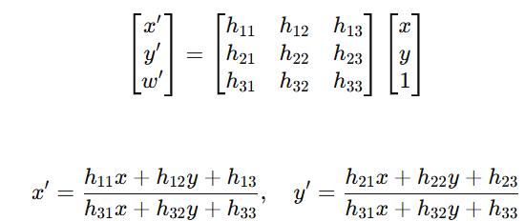
Projective (Homography) Transformation
Most general 2D transformation.
Straight lines remain straight, but parallel lines may converge.
Effect: Models perspective distortion.
Example: When viewing a rectangular object (like a book) from an angle — it appears trapezoidal.

Slide 9
Use of Geometric Transformations in Image Registration and Tracking
Image Registration: Aligns two or more images of the same scene.
Features (key points) are detected and matched across images.
A geometric transformation (Rigid, Affine, or Projective) aligns one image with another.
Example: Aligning medical or satellite images taken at different times.
Object Tracking: Estimates object motion between video frames.
Transformation models motion: translation, rotation, scaling, or perspective changes.
Affine or projective transformations handle complex motions.
Example: Tracking a moving vehicle or rotating object in a video sequence.
Summary:
Registration uses transformations to align images.
Tracking uses transformations to model and predict motion.

Slide 10
In Image Registration
Step 1: Feature Detection
Identify keypoints (e.g., corners, edges, feature descriptors like SIFT, SURF, or ORB).
Step 2: Feature Matching
Match corresponding points between the two images.
Step 3: Estimate Transformation
Based on matched points, estimate a transformation matrix:
Rigid (rotation + translation) – for small motions.
Affine – for planar scenes with mild viewpoint differences.
Projective (homography) – for strong perspective or camera motion.
Step 4: Apply Transformation
Warp one image using the estimated transformation to align it with the other.
Example:
Aligning two satellite images of the same area taken on different dates:
The terrain (planar) allows affine or projective registration.
Scaling, rotation, and translation correct misalignment.

Slide 11
In Object Tracking
Step 1: Model Object’s Motion
The movement of the object between frames can be approximated using a transformation.
Type of Motion | Suitable Transformation | Example
Pure translation | Translation matrix | Object moving straight
Rotation/Scale | Similarity transformation | Rotating fan blades
Complex deformation | Affine | Head tilting or vehicle turning
Perspective motion | Projective | Car moving toward/away from camera

Slide 12
In Object Tracking
Step 2: Estimate Parameters
The transformation parameters (like rotation angle, scale factor, etc.) are continuously updated using tracking algorithms such as:
Optical flow (Lucas–Kanade)
Template matching
Kalman or particle filters
Step 3: Predict Next Position
The estimated transformation predicts the object’s next location and shape

Slide 13
Transformation | Used In | Purpose
Scaling | Registration / Tracking | Adjust image size or object scale
Rotation | Both | Align object orientation
Affine | Registration / Tracking | Handle combined rotation, translation, scaling, shear
Projective | Registration | Handle viewpoint and perspective changes

Slide 14
Comparison of Transformations
Scaling – preserves shape, changes size.
Rotation – preserves shape and distance.
Affine – preserves parallelism only.
Projective – preserves straightness, not parallelism.
Complexity increases from scaling → rotation → affine → projective.

Slide 15
Applications in Computer Vision
Image Registration:
Aligns images from different viewpoints or times using geometric transformations.
Object Tracking:
Tracks object position and orientation across frames using affine/projective models.
Perspective correction, motion estimation, and camera calibration also rely on these transformations.

Slide 16
Example in Words
Imagine a drone flying and capturing video:
As the drone tilts, the ground view changes due to perspective (→ projective transformation).
If you align successive frames to build a map, you use registration.
If you keep following a car in that video, you use tracking — updating the car’s position via affine or projective motion.

